Slide 1

Ethics and Privacy
Guru Srinivasan

Slide 2
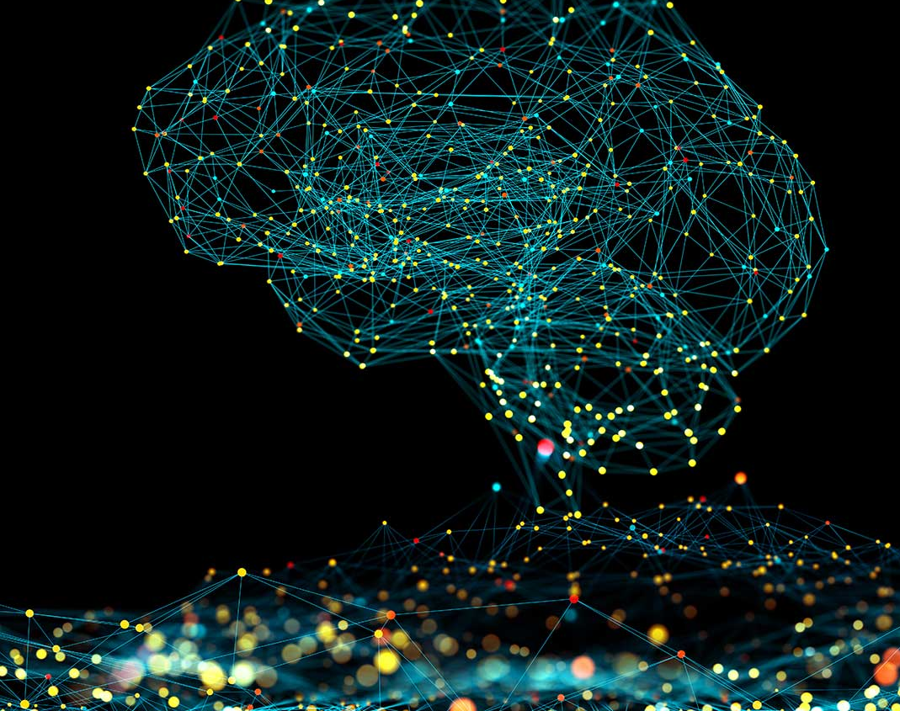
Contents
Ethical Computing
Privacy and ethical computing
Moral Reasons and Privacy
Intellectual Property Rights
Technology and solving privacy concerns

Slide 3
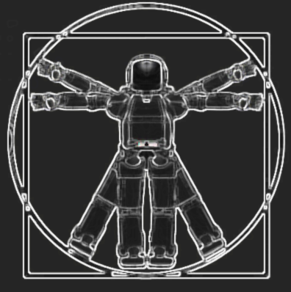

Ethical Computing
Defines set of moral standards that govern the use of computers
Concerns with areas on
Privacy
Data Storage and sharing
Unauthorised use including hacking
Governed through
Laws and Regulations such as
General Data Protection Regulation (GDPR),
Data Protection, and Intellectual Property Rights

Slide 4

Ethical Computing
Intellectual Property
Work that is the result of someone’s creativity and knowledge
Protected by copyrights, patents, and trademarks
Privacy
Control and privacy of information will continue to be a fine balancing act

Slide 5
Main Trends causing Ethical and Privacy Concerns
Increasing use of technology replacing human jobs
Data storage and access
Users tracked without their concerns
Increased data analytics predicting and influencing buying

Slide 6
Kind of Personal information easily accessible
Person‘s date of birth, sexual preference, location, religion
IP address of computer or metadata pertaining to these information.
More implicit in the form of behavioural data – children, pets, spouse
Personal opinions and views through social media
Professional information

Slide 7
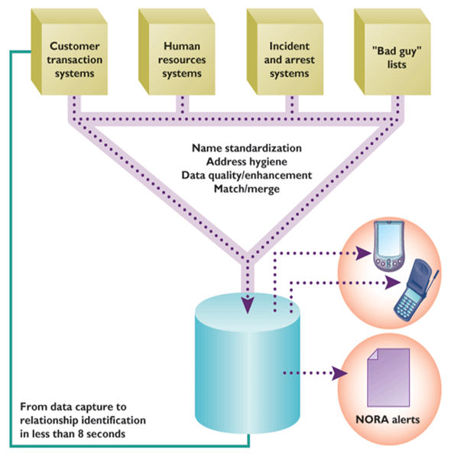
Ethical Computing and Privacy
Social Justice
Predictive policing to prevent crime vs monitoring personal information
Military secrets and previously secret documents (WikiLeaks, Panama Papers) vs Access to information
Liability
3D printing can lead to quality control issues
Censorship
Global differences in website blocking
Notes:
Predictive policing to prevent crime using Echelon and NORA vs monitoring personal information

Slide 8
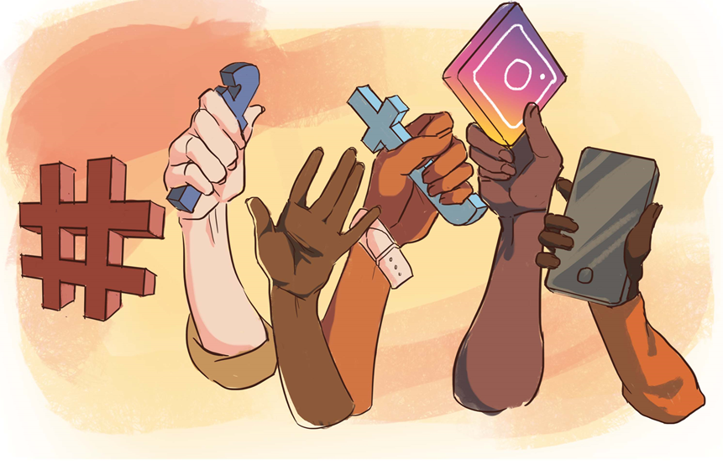
Ethical Computing and Privacy (Contd.)
Social Activism
Hacktivism is using computers and computer networks in a subversive way
Often manifests as Denial of Service (DOA) attacks
Automated Systems and Robotics
Self Checkouts and Self-driving cars
Choose between sets of bad choices
Influencing
Cyber Bullying
Reviews for sale

Slide 9
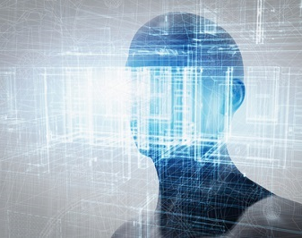
Moral Reasons for Privacy
Prevention of harm: - Access by others to one‘s bank account, profile, social media account, cloud repositories, characteristics, and whereabouts can be used to harm the data subject in a variety of ways.
Informational inequality: Personal data have become commodities. Users have no control over Flexible pricing, price targeting and price gauging, dynamic negotiations are typically undertaken on the basis of asymmetrical information and great disparities in access to information. Choice modelling in marketing, micro-targeting in political campaigns, and nudging in policy implementation exploit a basic informational inequality of principal and agent.
Informational injustice and discrimination: Personal information provided in one sphere or context (for example, health care) may change its meaning when used in another sphere or context (such as commercial transactions) and may lead to discrimination and disadvantages for the individuals
Encroachment on moral autonomy and human dignity: Lack of privacy may expose individuals to outside forces that influence their choices and bring them to make decisions they would not have otherwise made.
Notes:
Prevention of harm: Unrestricted access by others to one‘s bank account, profile, social media account, cloud repositories, characteristics, and whereabouts can be used to harm the data subject in a variety of ways.
Informational inequality: Personal data have become commodities. Individuals are usually not in a good position to negotiate contracts about the use of their data and do not have the means to check whether partners live up to the terms of the contract. Data protection laws, regulation and governance aim at establishing fair conditions for drafting contracts about personal data transmission and exchange and providing data subjects with checks and balances, guarantees for redress and means to monitor compliance with the terms of the contract. Flexible pricing, price targeting and price gauging, dynamic negotiations are typically undertaken on the basis of asymmetrical information and great disparities in access to information. Also choice modelling in marketing, micro-targeting in political campaigns, and nudging in policy implementation exploit a basic informational inequality of principal and agent.
Informational injustice and discrimination: Personal information provided in one sphere or context (for example, health care) may change its meaning when used in another sphere or context (such as commercial transactions) and may lead to discrimination and disadvantages for the individual. This is related to the discussion on contextual integrity by Nissenbaum (2004) and Walzerian spheres of justice (Van den Hoven 2008).
Encroachment on moral autonomy and human dignity: Lack of privacy may expose individuals to outside forces that influence their choices and bring them to make decisions they would not have otherwise made. Mass surveillance leads to a situation where routinely, systematically, and continuously individuals make choices and decisions because they know others are watching them. This affects their status as autonomous beings and has what sometimes is described as a “chilling effect” on them and on society. Closely related are considerations of violations of respect for persons and human dignity. The massive accumulation of data relevant to a person‘s identity (e.g. brain-computer interfaces, identity graphs, digital doubles or digital twins, analysis of the topology of one‘s social networks) may give rise to the idea that we know a particular person since there is so much information about her. It can be argued that being able to figure people out on the basis of their big data constitutes an epistemic and moral immodesty (Bruynseels & Van den Hoven 2015), which fails to respect the fact that human beings are subjects with private mental states that have a certain quality that is inaccessible from an external perspective (third or second person perspective) – however detailed and accurate that may be. Respecting privacy would then imply a recognition of this moral phenomenology of human persons, i.e. recognising that a human being is always more than advanced digital technologies can deliver.

Slide 10
General Data Protection Regulation
The General Data Protection Regulation 2016/679 is a regulation in EU law on data protection and privacy in the European Union and the European Economic Area
The GDPR sets out seven key principles:
Lawfulness, fairness and transparency
Purpose limitation
Data minimisation
Accuracy
Storage limitation
Integrity and confidentiality (security)
Accountability

Slide 11
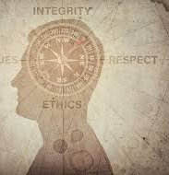
Intellectual Property Rights
Have you shared a copy of photograph not take by yourself on social media?
Ever recorded a movie and shared?
Shared an article or news report?
Shared music?
Shared Netflix password?
Shared software?

Slide 12
Intellectual Property Rights
Term used to describe work that are intangible creative work
In legal forms it can be
Trademark
Copyright
Patents
Trade secrets

Slide 13
Forms of Intellectual Property Right violations
Plagiarism
Reverse Engineering
Competitive Intelligence
Cyber Squatting

Slide 14
How can information technology itself solve privacy concerns?
Design methods - The privacy by design approach provides high-level guidelines in the form of principles for designing privacy-preserving systems.
Privacy enhancing technologies – Cryptographic techniques and security protocols, communication-anonymizing tools such as Tor and Freenet, and identity-management systems
Cryptography – Encrypt data stored
Identity management – Multi-factor authentication

Slide 15

Questions

